Slide 1

Minor Project Optical character recognition ( O.C.R )
Vaibhav Hariramani (18bcs6136)
Hrithik johri (18bcs6145)
kshitiJ Murabatte (18bcs6146)
aditya gupta (18bcs6152)
Sahil kumar (18bcs6224)

Slide 2
Content
Introduction
Definition of OCR
Application of OCR
Platform Used
Working of OCR
Project Overview
Future Enhancements and Prospects
Conclusion
References

Slide 3
Introduction
Nowadays, a lot of paper documents are transformed to electronic form, which makes information processing easier, like searching, analysis and conversion.
Many companies and other institutions decide to digitalize their documents. Working with files is cheaper than processing traditional documents, because there is no space required for document storage. There are three main steps of document digitalization: scanning, indexation (data entry) and presentation of digitalized documents.
Humans are bound to make errors – some time or the other – especially while performing mundane and boring tasks like digitization or security, continuously.
Many times we are unable to perceive certain digits due to various factors – motion, lack of digit clarity &/or illumination and so on.
It is these problems which have primarily lead us to delve into this topic.

Slide 4
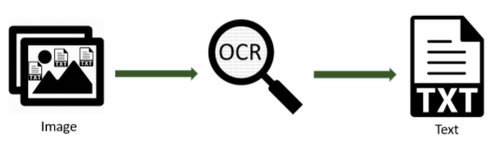
Definition of OCR
Optical Character Recognition or OCR is a system that provides a full alphanumeric recognition of printed or handwritten characters at electronic speed by simply scanning the form.

Slide 5
It is the mechanical or electronic conversion of scanned or photographed images of typewritten or printed text into machine-encoded/computer readable text.
2. Involves the mechanical/electronic conversion of scanned images of typewritten/printed text into machine encoded/computer-readable text.
OCR is a field of research in pattern recognition, artificial intelligence and computer vision. It is the electronic translation of handwritten, typewritten or printed text into machine translated images.
Common method of digitizing printed texts .
OCR is a field of research in pattern recognition, artificial intelligence and computer vision.

Slide 6
Applications of OCR
Data entry for business documents, e.g. check, passport, invoice, bank statement and receipt.
Automatic number plate recognition .
Automatic insurance documents key information extraction
Extracting business card information into a contact list
Extracting business card information into a contact list  More quickly make textual versions of printed documents, e.g. book scanning for Project Gutenberg .
Make electronic images of printed documents searchable, e.g. Google Books .
Converting handwriting in real time to control a computer (pen computing)
Assistive technology for blind and visually impaired users

Slide 7
Platform Used
VS Code
Android Studio
App Development
Flutter

Slide 8
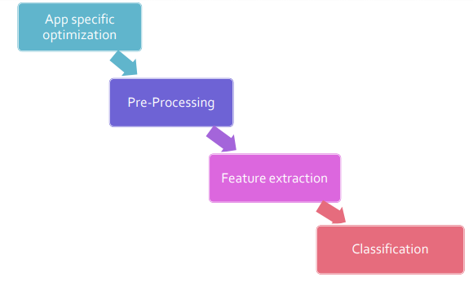
Working of OCR

Slide 9
Pre-processing:
Deals with improving quality of the image for better recognition by the system.
Techniques include – De- skew , DE speckle , Binarization ,Line removal
Character recognition:
There are two basic types of core OCR algorithm which may produce a ranked list of candidate character
Matrix matching and Feature extraction
Post-processing:
OCR accuracy can be increased if the output is constrained by lexicon. Eg. all the words in the English language can be problematic if the document contains words that are not in the lexicon, like proper nouns.

Slide 10
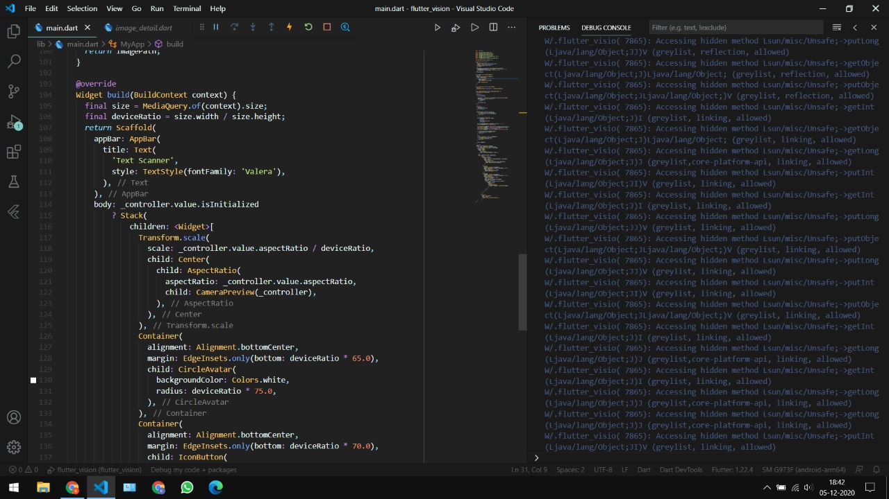
Project Overview

Slide 11
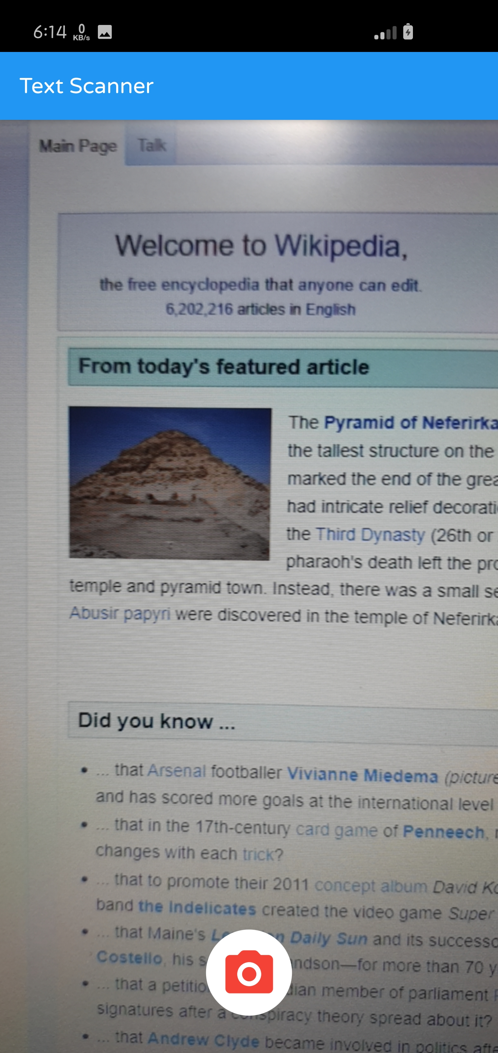
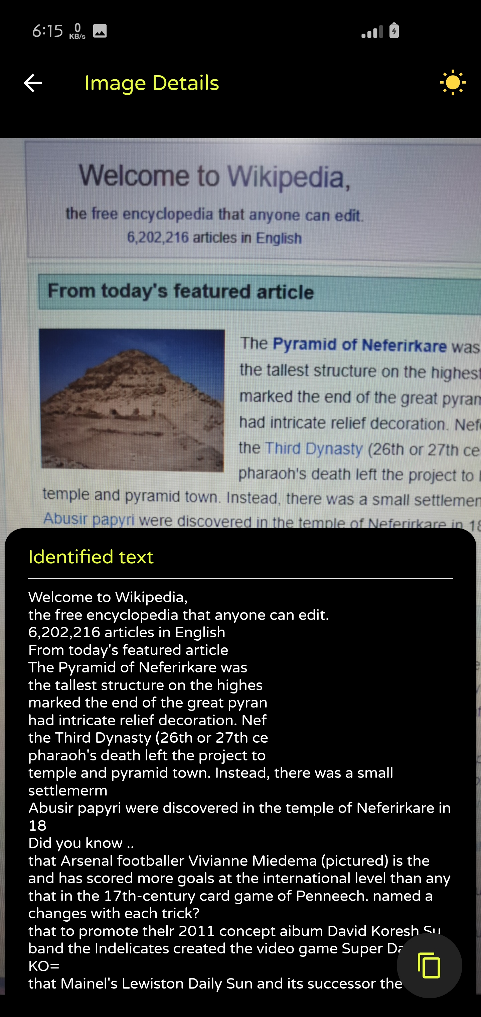
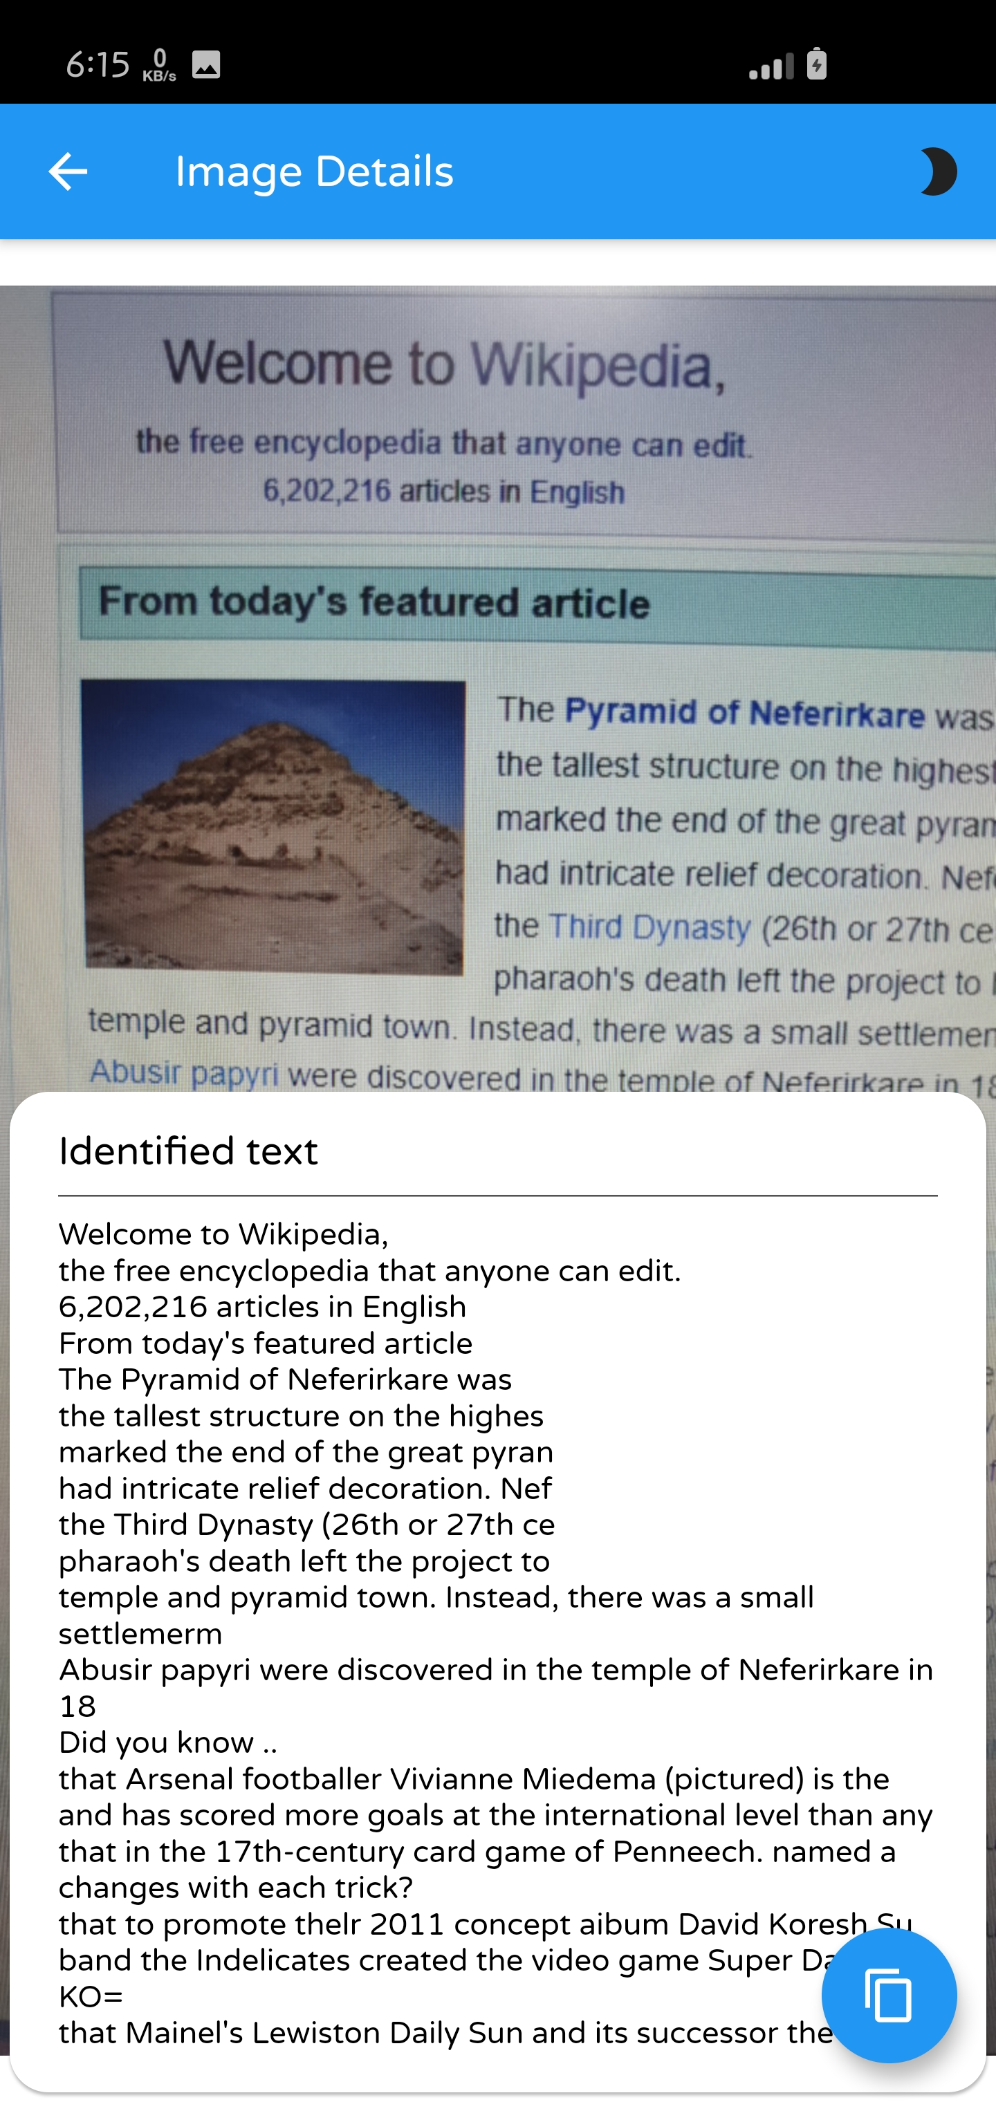

Slide 12
Future Enhancements and Prospects
Currently, the scope of our engine extends to recognizing one character at a time.
We propose to extend this functionality to enable the accurate prediction of multiple characters simultaneously – thereby enabling truly real time Character Recognition.
Also, we shall delve further into the implementation of Neural Networks and come up with methods to increase our accuracy levels.
Last, but not the least, we shall develop a GUI which shall enable greater User usability and popularity

Slide 13
Conclusion
OCR technology provides fast, automated data capture which can save considerable time and labor costs of organizations.
The system has its advantages such as Automation of mundane tasks, Less Time Complexity, Very Small Database and High Adaptability to untrained inputs with only a small number of features to calculate.
Though researchers have suggested various sophisticated ideas and techniques, practical OCR systems suffer from a lack of various characteristics. It is because of the claims made by the researchers are not adequately justified by exposure of the systems into real working environments and the lack of practical feasibility of such advanced techniques with the available hardware from an economical viewpoint..

Slide 14
References
Vaibhav : https://www.linkedin.com/in/vaibhav-hariramani-087488186
Hrithik : https://www.linkedin.com/in/hrithik-johri-a0424b195/
Kshitij : https://www.linkedin.com/in/kshitij-murabatte-63a4331b2
Aditya : https://www.linkedin.com/in/aditya-gupta-400182194
Sahil : https://www.linkedin.com/in/sahilkumar098

Slide 15
THANK YOU!

